Slide 1
Praesepe
By: Lia, Grace, Bre, Alicia

Slide 2
History of Praesepe
Praesepe, also called The Beehive Cluster, (catalog numbers NGC 2632 and M 44), open, or galactic, cluster of about 1,000 stars in the zodiacal constellation Cancer and located about 550 light-years from Earth. Visible to the unaided eye as a small patch of bright haze, it was first distinguished as a group of stars by Galileo. It was included by Hipparchus in the earliest known star catalog, c. 129 BC.
The name Praesepe (Latin: “Cradle,” or “Manager”) was used even before Hipparchus’ time. The name Beehive is of uncertain but more recent origin.
The Beehive Cluster has been known since ancient times. The Greek astronomer Ptolemy described the object as “the nebulous mass in the breast of Cancer.” The philosopher Aratus of Soli called the cluster Achlus, meaning “little mist,” in his poem Phaenomena (260-270 B).
Notes:
lia

Slide 3
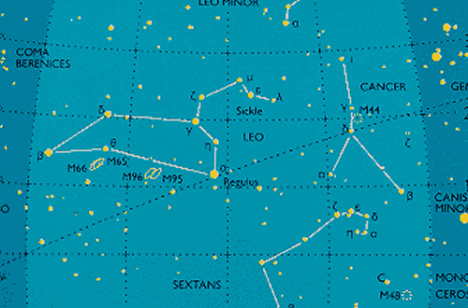
Facts
At least 1,000 stars which are gravitationally bound
Total mass Messier 44 = 500 to 600 solar masses
Brightest stars in the Beehive Cluster have an apparent magnitude of 6 to 6.5 and are blue-white in colour
The brightest star in Messier 44 is ε Cancri (Epsilon Cancri), a hot blue-white star belonging to the spectral class A, with an apparent magnitude of 6.3
Massive stars are concentrated in the central region while, the fainter/less massive stars are found in the cluster’s halo
According to a recent analysis of the cluster, 68 percent of its stars are M-class red dwarfs, 2% are brilliant class A stars, and 30% are stars with spectral classes F, G, and K that are equivalent to the Sun.
Notes:
lia
Here are some fast facts:
Praesepe contains at least 1,000 stars which are gravitationally bound
The total mass of Messier 44 is estimated at 500 to 600 solar masses
Brightest stars in the Beehive Cluster have an apparent magnitude of 6 to 6.5 and are blue-white in colour
The brightest star in Messier 44 is ε Cancri (Epsilon Cancri), a hot blue-white star belonging to the spectral class A, with an apparent magnitude of 6.3
Massive stars are concentrated in the central region while, the fainter/less massive stars are found in the cluster’s halo
According to a recent analysis of the cluster, 68 percent of its stars are M-class red dwarfs, 2% are brilliant class A stars, and 30% are stars with spectral classes F, G, and K that are equivalent to the Sun.

Slide 4
Our Goal
Some of our goals during this project were…
Learn to work together
Teach other about the star Praesepe and it’s cluster
Get more familiar with reading in certain and dataframes making graphs to go along with those dataframes
Creating a color magnitude diagram based on Praesepe star data to visualize the relationship the absolute magnitude of stars and the colors
Why coding? Why these libraries?
We imported the numpy library to calculate the absolute magnitude, the pandas library to read in our data and the matplotlib.pyplot library to be able to graph the visual correctly.
Notes:
Breanna

Slide 5



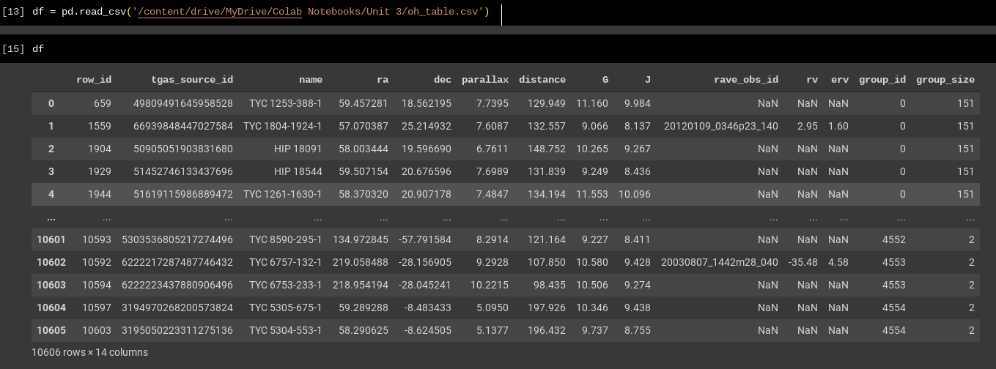
We needed numpy for the np.log10()
We needed pandas for reading csv files
Notes:
Made by:Lia
Presented by lia

Slide 6
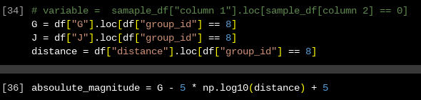
G is a variable for the column “G” from the DataFrame and .loc of “group_id” from the DataFrame as well
J and distance are both structured the same way
variable = sample_df[ “column 1” ].loc[sample_df[ “column 2” ] == 0 ]
absoulute_magnitude contains G - 5 * np.log10(distance) + 5
Notes:
Breanna
Made by: Lia

Slide 7
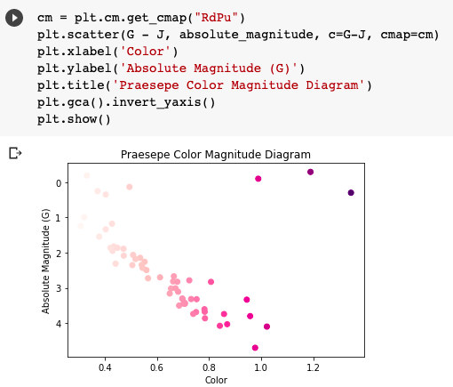
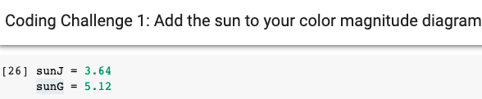
RdPu = colormap
X label = Color
Y label = Absolute Magnitude (G)
Title = Praesepe Color Magnitude Diagram
Inverted Y Axis
Values for sunJ and sunG so they can be added to the color magnitude diagram!
Notes:
Grace
First we created the variable CM for color map and created a line of code that would act as the first step in plotting our visual. Then in parentheses and quotation marks on that same line we indicated that we were using the RdPu red and purple color map. To include all of the correct data on our visual we used plt.scatter to include G-J, the absolute magnitude, c = G-J and cmap=cm to include the colormap. Then we labeled the x axis Color and the y axis Absolute Magnitude (G). We titled the visual Praesepe Color Magnitude Diagram. To make sure that the axis’ were showing the right values in the order that we wanted them to we inverted the y axis so that it would be decreasing in absolute magnitude. We also added the values of sunJ and sunG so that we could plot the sun in our final visual shown in the next slide

Slide 8
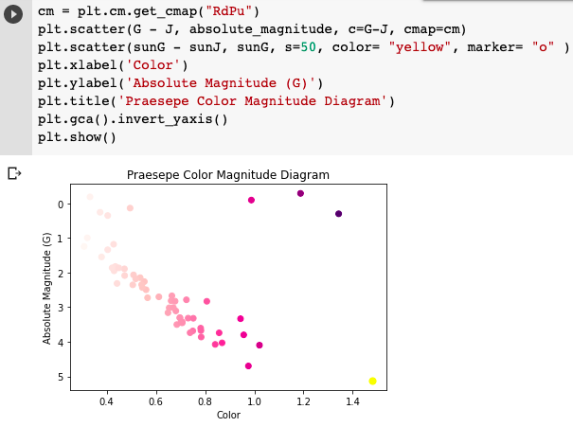
Notes:
Grace
Here is our final visual. We added the third line of code in order to display the sun shown as a yellow circle marker near the bottom right! We subtracted sunG and sunJ, assigned the marker as a circle with the letter o, and assigned the color of the marker as yellow. It displayed in our graph because of the use of the plt.show() function

Slide 9
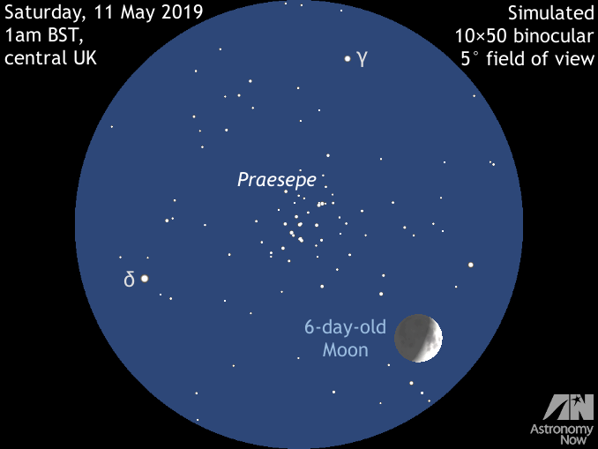
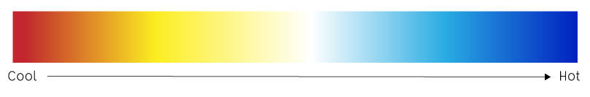
Scientific Conclusions
As color increases the absolute magnitude (g) decreases
Cooler colors correlate to a lesser absolute magnitude while warmer colors correlate to a greater absolute magnitude
the magnitude of a celestial object is measured in wavelengths or colors
Notes:
Who is reading this slide: Alicia?
After completing our visual and interpreting all of the data we have come to the conclusion that as color increases the absolute magnitude decreases.
In the visual you can see Praesepe as well as a graph that shows the cool and warm colors.

Slide 10
Challenges and Solutions
Trouble importing the files and initially finding our slides
We were able to successfully find the files, upload them to our Drive and find our slides on the Slack Channel!
Getting errors in our code and not knowing where to start coding for our visual
Asking for help from Carol and the Junior TA’s helped enormously and we were able to understand our problems!
At first we were unable to find the color map to use in visual
We were guided to the link in the Slack channel where we were able to find and choose the right color map!
Notes:
Grace
Throughout our code we faced many challenges on the road to completing our project.
One of our errors was using the wrong group id we used 8 instead of 6 but we were able to fix it and our graphs show the correct data set
Through online documentation like the color map guide, different cheat sheets and quick google searches we were able to find the solutions to many of our problems.
Being able to communicate on slack is also really important and a great tool that also helped us in our project!

Slide 11
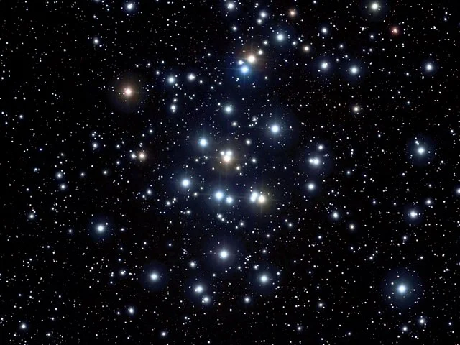
Next Steps
Our first next step would be to publish our data and our visuals to show as many people as we can our findings. If we are able to send out this data to many people, everyone would know about the Praesepe star cluster
Another step we could take would be to investigate more about the star cluster and find information about temperatures that we could add to our graph! This would give the data another perspective and make it even more informative.
Notes:
Breanna

Slide 12
Sources
https://earthsky.org/clusters-nebulae-galaxies/praesepe-beehive-cluster/#:~:text=An%20older%20name%20is%20Praesepe,it%20contains%20a%20thousand%20stars.
https://www.constellation-guide.com/praesepe-m44-the-beehive-cluster/
https://www.britannica.com/place/Praesepe

Slide 13
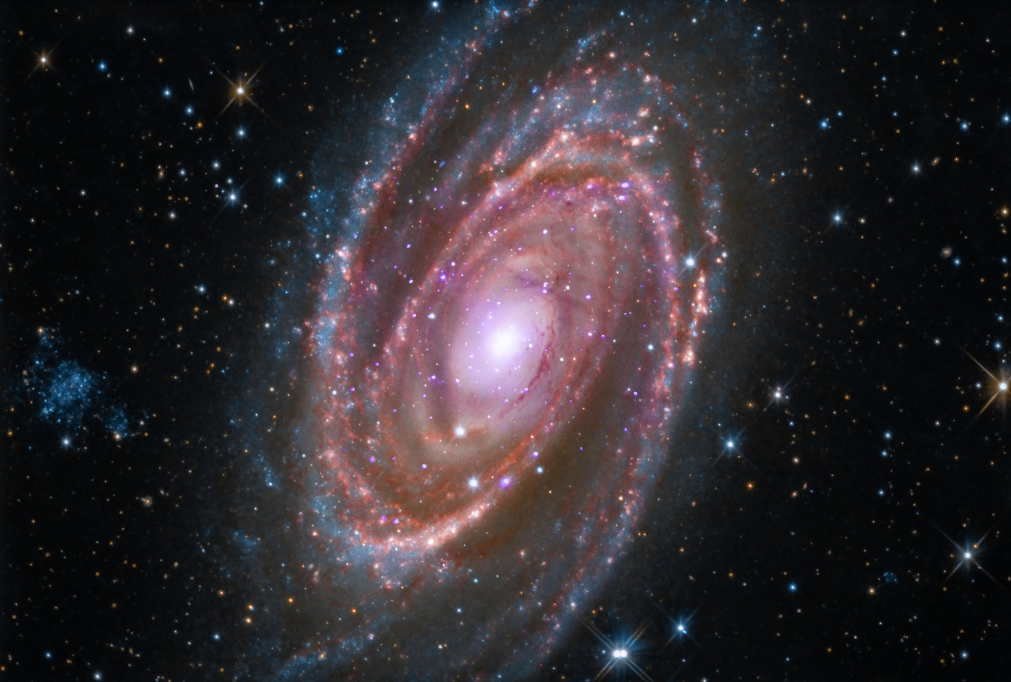
THANK YOU FOR LISTENING!!

